Slide 1

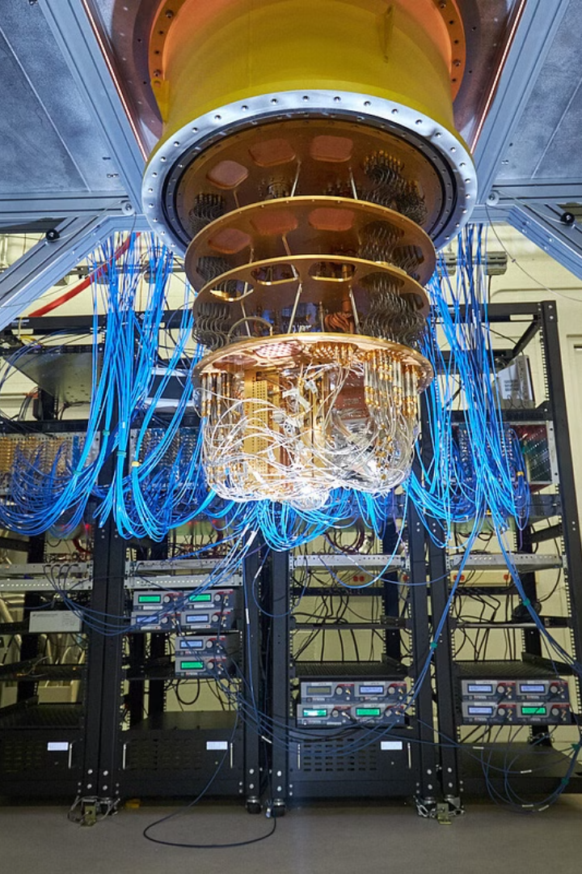

Introduction to Quantum Simulation
Quantum simulation is the emulation of quantum systems using a different, more controllable quantum system to study behaviors that are difficult to simulate classically. It enables the study of complex quantum phenomena that are challenging to replicate in a laboratory setting.

Slide 2
Applications of Quantum Simulation
Material Science
Quantum Chemistry
Quantum Computing
Quantum simulation aids in the discovery and development of novel materials with unique properties, revolutionizing various industries.
It facilitates the understanding and design of chemical reactions and compounds at a quantum level, paving the way for innovative drug discovery.
By simulating quantum algorithms and systems, it contributes to the advancement of quantum computing, promising unprecedented computational power.

Slide 3
Challenges and Future Prospects in Quantum Simulation
1
Scalability
2
Noise and Error Mitigation
Addressing the challenge of scaling up quantum simulation to handle larger, more intricate systems and phenomena.
Developing techniques to minimize errors caused by environmental factors and improve overall accuracy.
3
Applications in Real-World Scenarios
4
Interdisciplinary Collaboration
Unifying efforts across fields to leverage diverse expertise for solving complex quantum simulation challenges.
Exploring new frontiers for utilizing quantum simulation in practical scientific and industrial applications.

